Slide 1
Data Society Case Study: Energy USAGE
By Eric Eells
4/12/24

Slide 2
Agenda
Problem Statement
Exploratory Data Analysis
Model Selection
Results
Conclusion

Slide 3

Problem Statement
After recent power optimization efforts, is the company on track to consume less real energy next month?

Slide 4
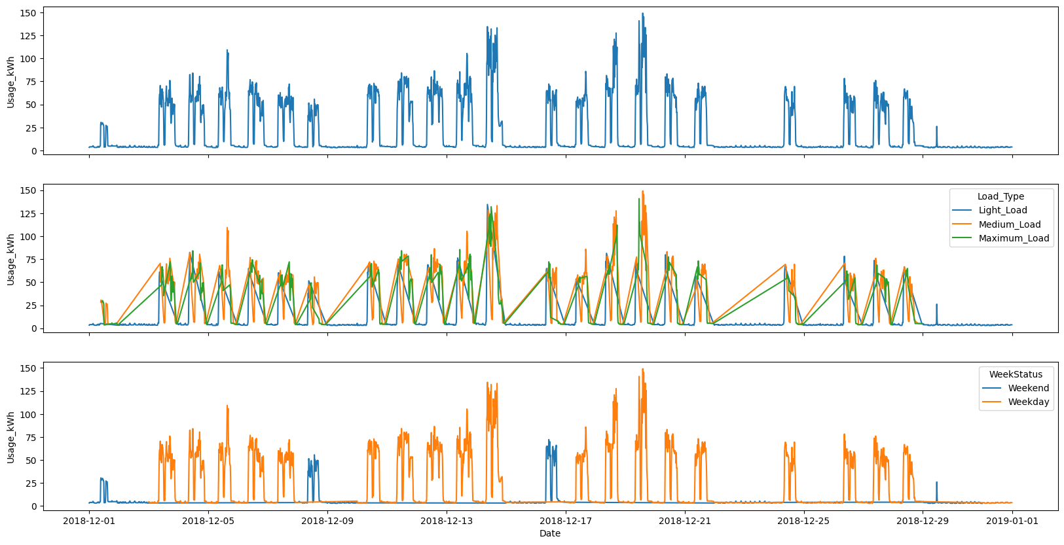
Exploratory Data Analysis
Variable: Industry Energy Consumption (kWH)
Variability: High
Distribution: Right Tail
Outliers: True
Nulls: False
Stationary: True
Other: Categorical overlap, 15 min intervals

Slide 5
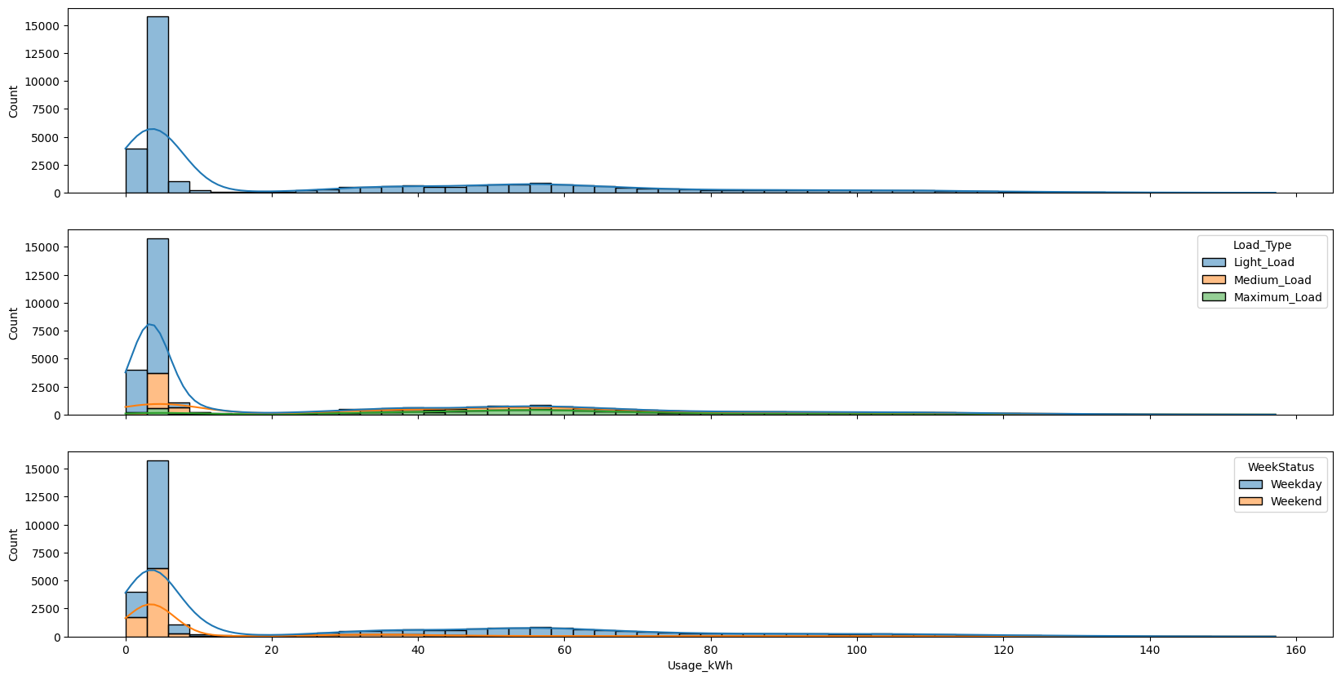
Exploratory Data Analysis
Variable: Industry Energy Consumption (kWH)
Variability: High
Distribution: Right Tail
Outliers: True
Nulls: False
Stationary: True
Other: Categorical Overlap & 15 Min Intervals

Slide 6
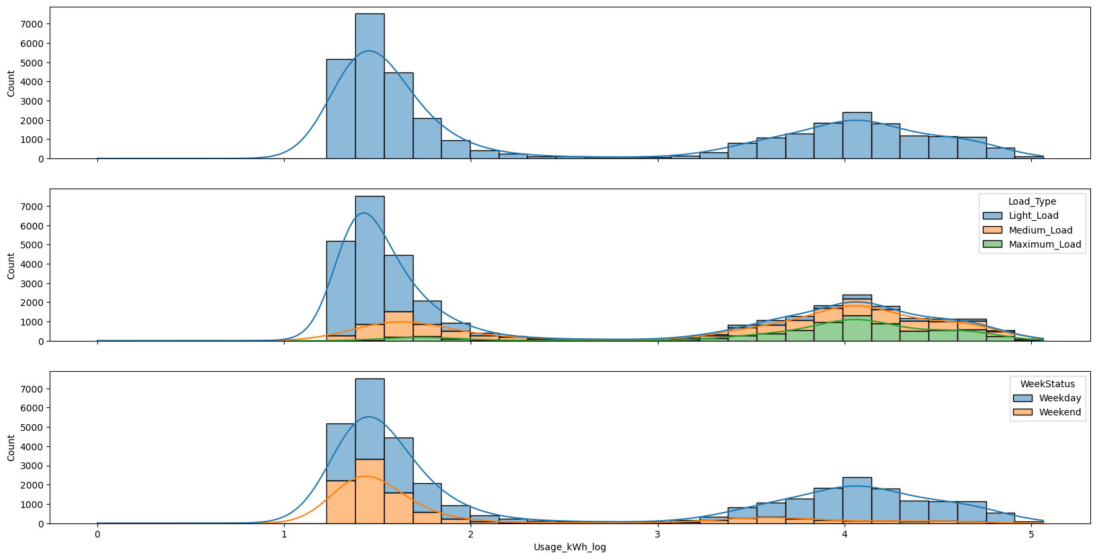
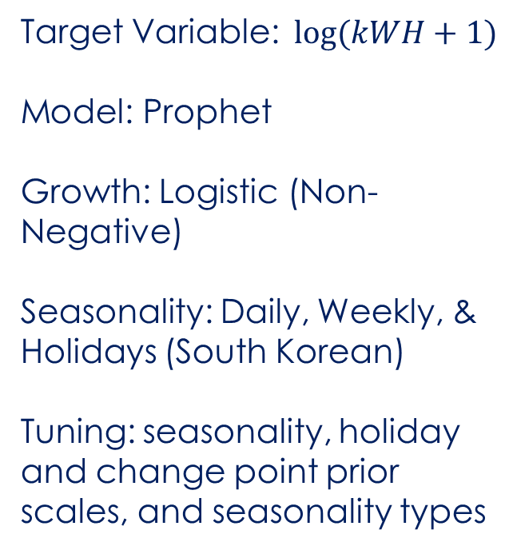
Model Selection
Target Variable: $log⁡(kWH+1)$
Model: Prophet
Growth: Logistic (Non-Negative)
Seasonality: Daily, Weekly, & Holidays (South Korean)
Tuning: seasonality, holiday and change point prior scales, and seasonality types
Notes:
Prophet: additive model where non-linear trends are fit with yearly, weekly, and daily seasonality, plus holiday effects

Slide 7
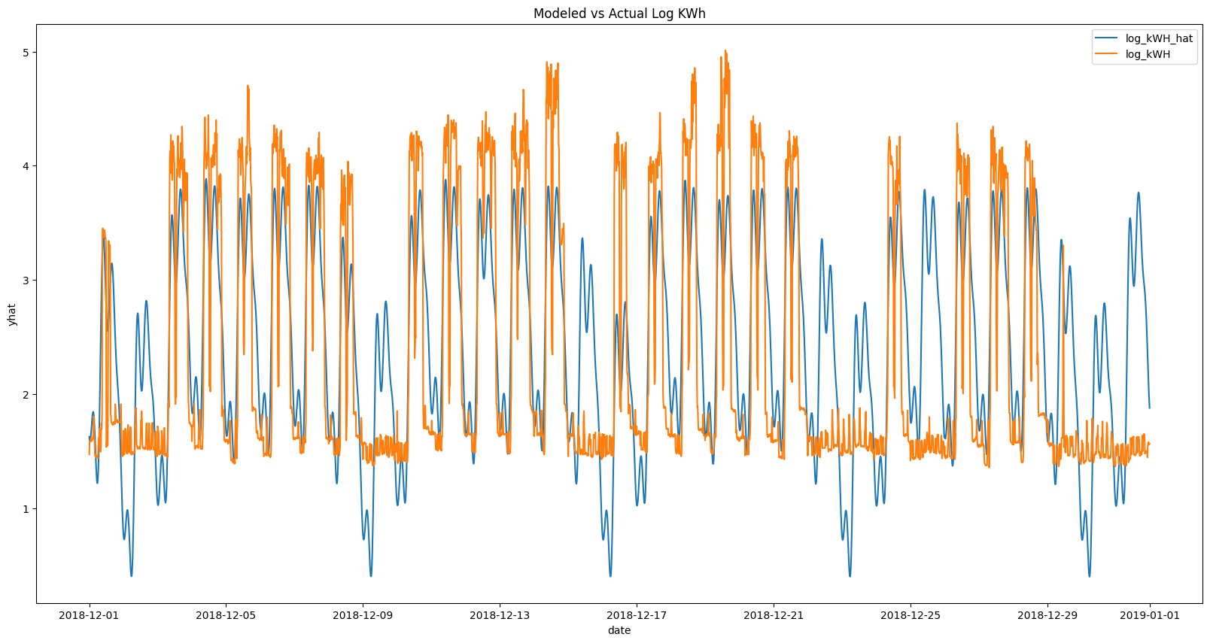
Results
Predicted Jan’19: 45.372 MWH
Predicted M/M Chg: -14.064 MWH
Predicted Y/Y Chg: -80.866 MWH
The model captures some oscillations in the data, but fails to incorporate weekend downtimes

Slide 8
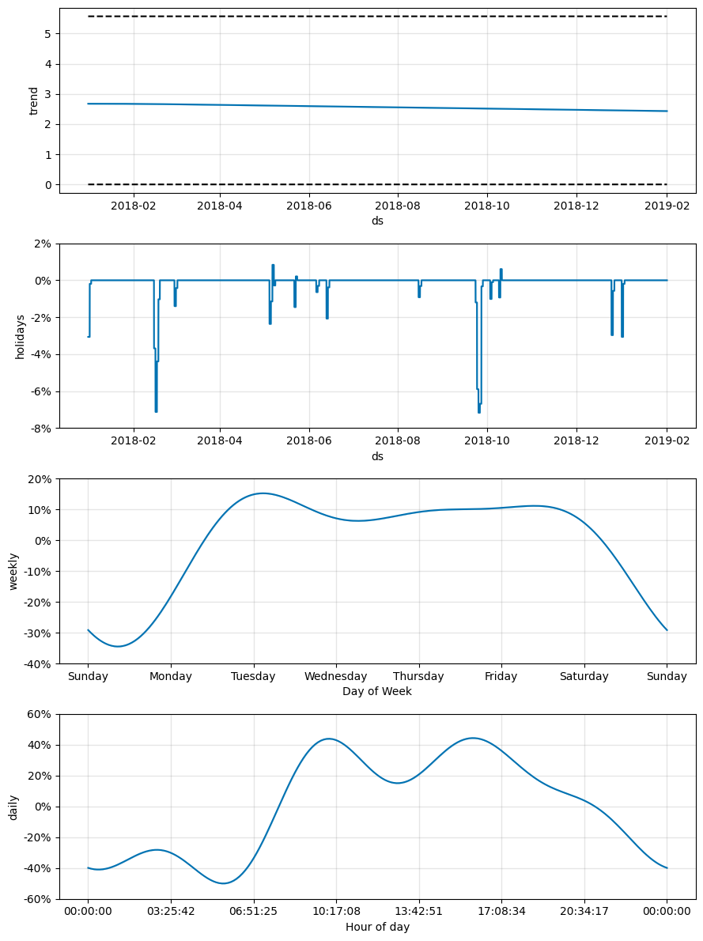
Results
Holiday seasonality appears logical, as facilities are assumed to close
Higher mid week and day (excluding lunch) energy utilization looks reasonable

Slide 9
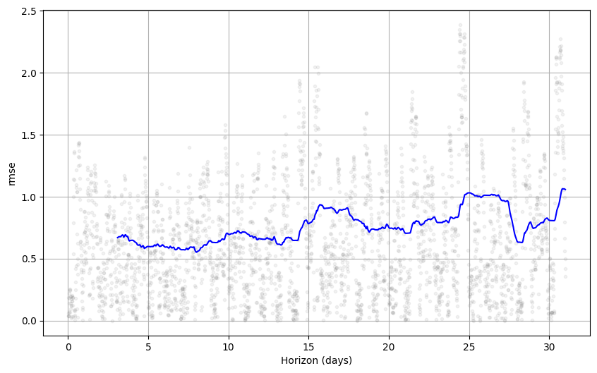
Results
Root Mean Squared Error (RMSE):
kWH: 20.44
Log(kWH+1): 0.78
High frequency of predictions cause model accuracy to degrade over time

Slide 10

conclusion
The Prophet model picks up some trends but leave something to be desired for precise point in time estimates.
The model supports the company’s energy optimization efforts, as energy consumption is expected to decrease.

Slide 11

Questions?

Slide 12
Thank you
Eric Eells
972-754-2424
ericeells198@gmail.com

Slide 13
Appendix

Slide 14
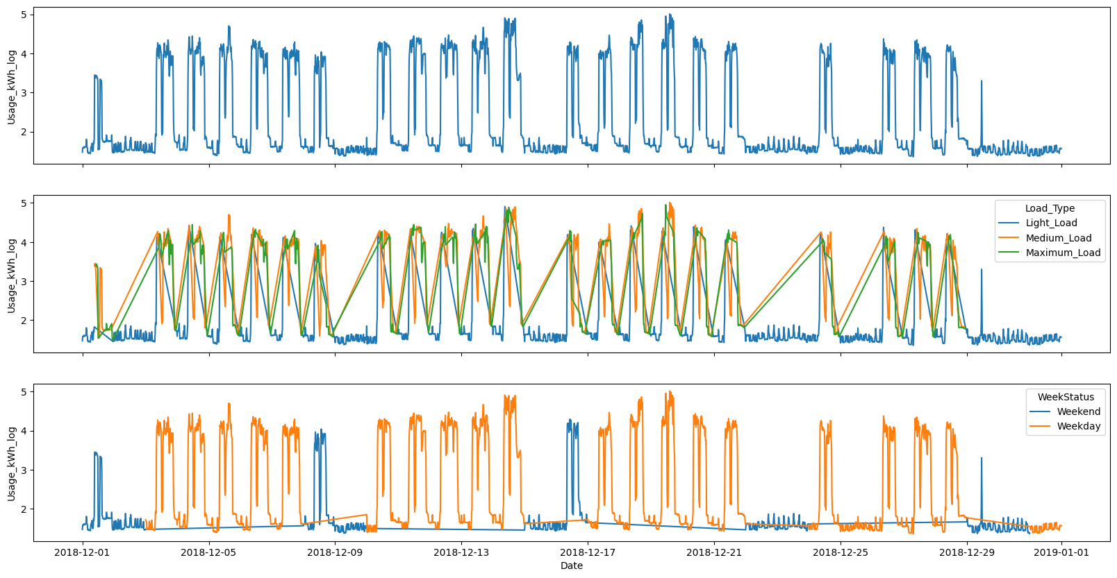
Log transformation
The transformation maintains the data patterns

Slide 15
Prophet Hyperparameters
Default:
{'growth’: linear',
'holidays': None,
'seasonality_mode’: additive',
'changepoint_prior_scale’: 0.05,
seasonality_prior_scale': 10,
holiday_prior_scale': 10,
'yearly_seasonality’: True,
'weekly_seasonality': True,
'daily_seasonality': True,
'interval_width': 0.9}
Optimized:
{'growth': 'logistic',
'holidays’: events,
'seasonality_mode': 'multiplicative',
'changepoint_prior_scale': 0.001,
seasonality_prior_scale’: 0.01,
holiday_prior_scale’: 0.01,
'yearly_seasonality': False,
'weekly_seasonality': True,
'daily_seasonality': True,
'interval_width': 0.9}

Slide 16
Opportunities
Hyperopt hyperparameter search
Alternative model testing (e.g. AIRMA)
Multivariate forecasting (e.g. WeekStatus)

